Slide 1
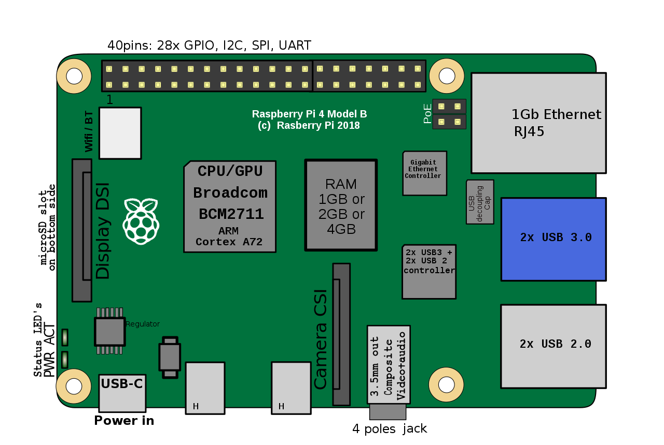
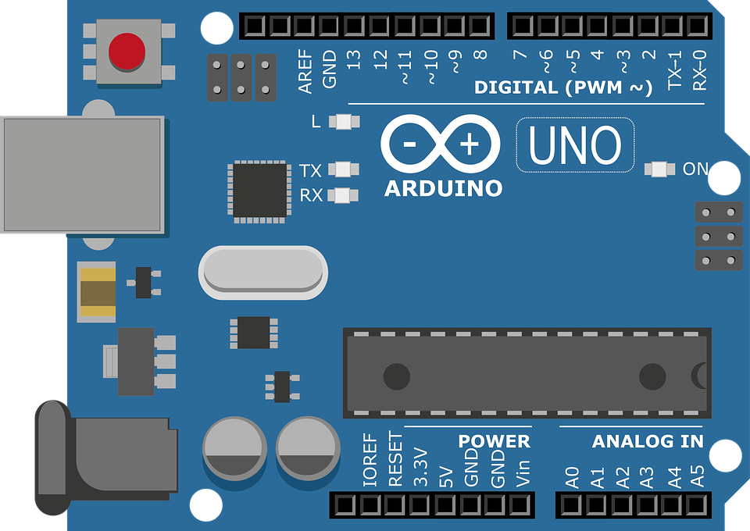
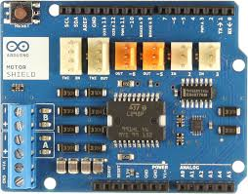
Track connections or DCC Bus
Wall power outlet
Power Supply
14v - 18v
1 to 2 Amp
depending on scale
Programming Track
USB A - USB B Cable
Motor Shield sits on top of the UNO.
Ensure pins line up with sockets and go fully home.
Cut the trace between the two Vin Connect solder pads on the underside of the shield.
Link Pins
13 & 5
Link Pins
12 & 10
Use a suitably sized solid core wire for both links. You want a good connection.
Micro USB Power Supply
Micro
SD Card
Raspberry Pi Revision 4
Arduino UNO
Arduino Motor Shield Revision 4

